Slide 1


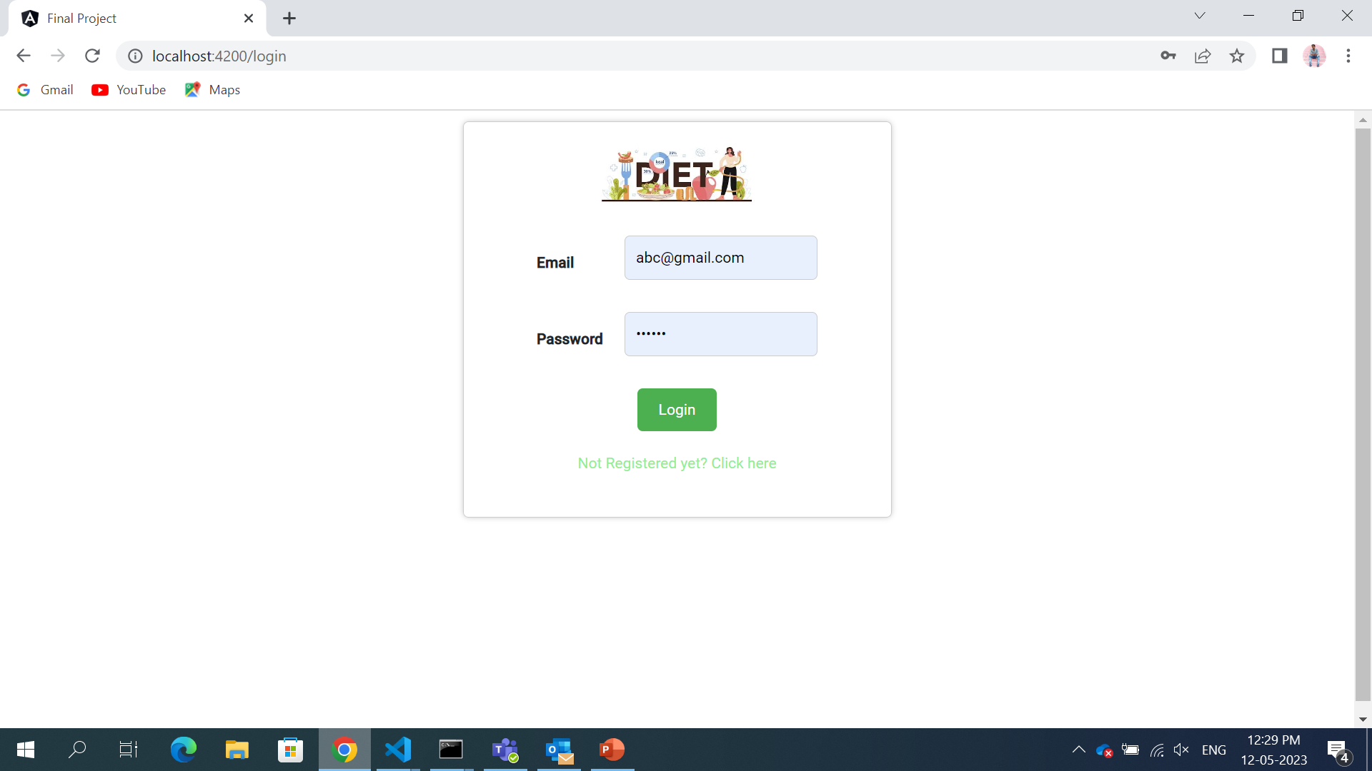
Diet Fit pro
In this Both admin and user can login with their credentials .
Signup we can register New user.
This is Implemented using Login component.
Once credentials Are correct it will Go to Dashboard.
Password will Encrypted and saved as token in json server auth.

Slide 2
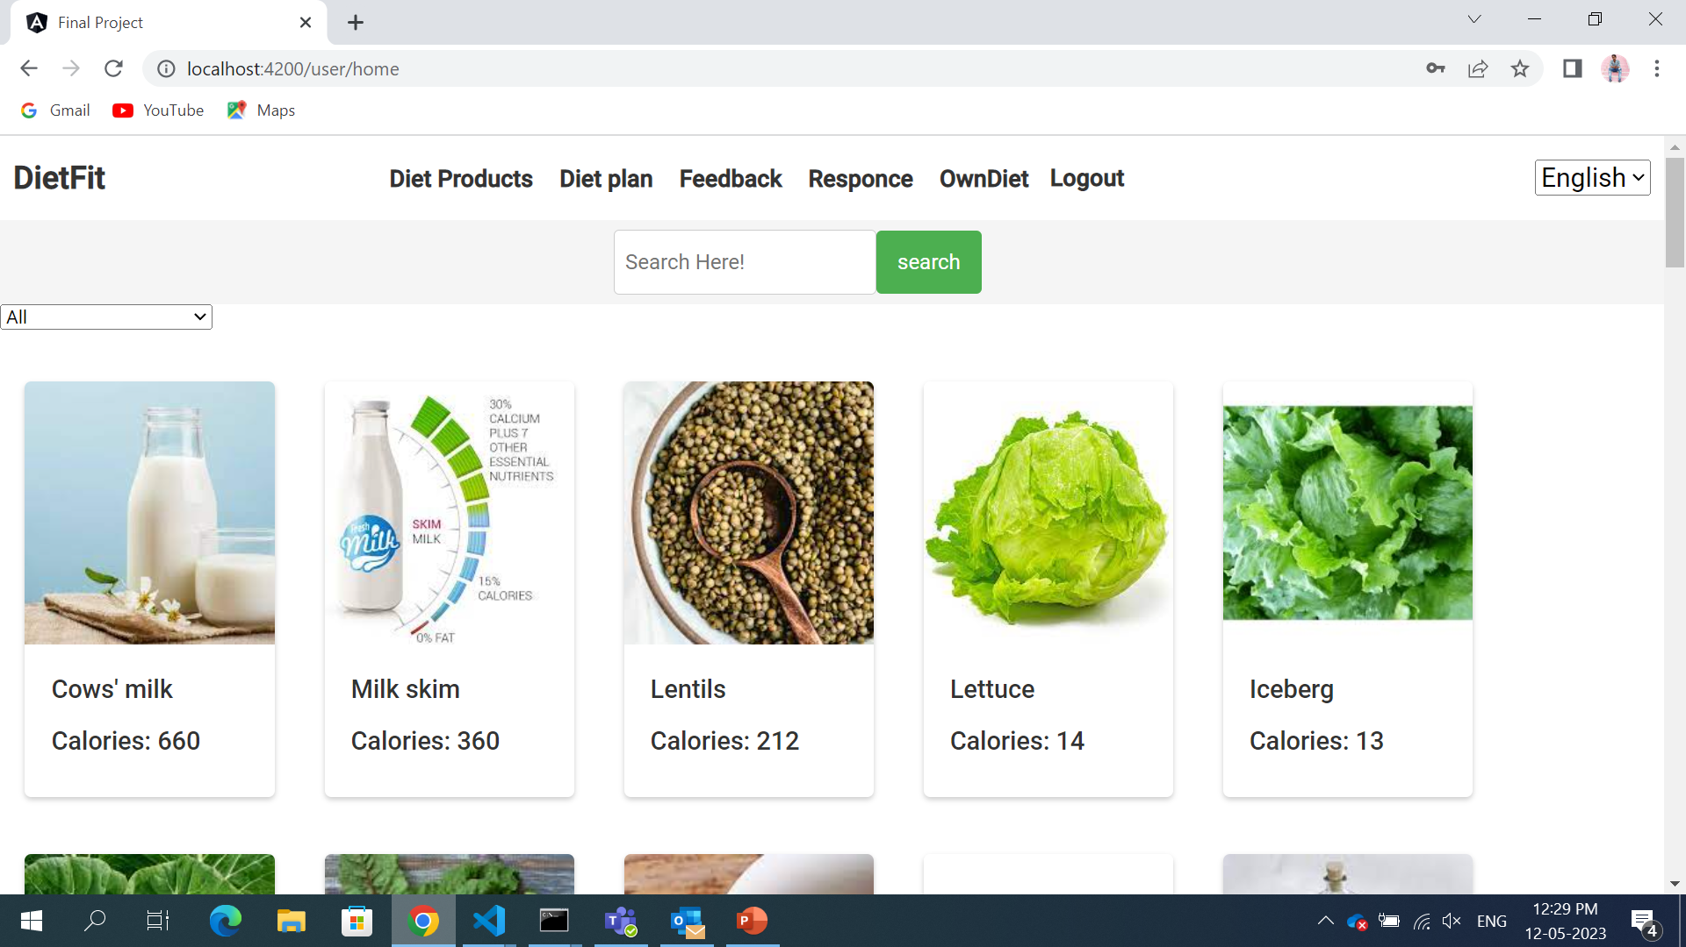
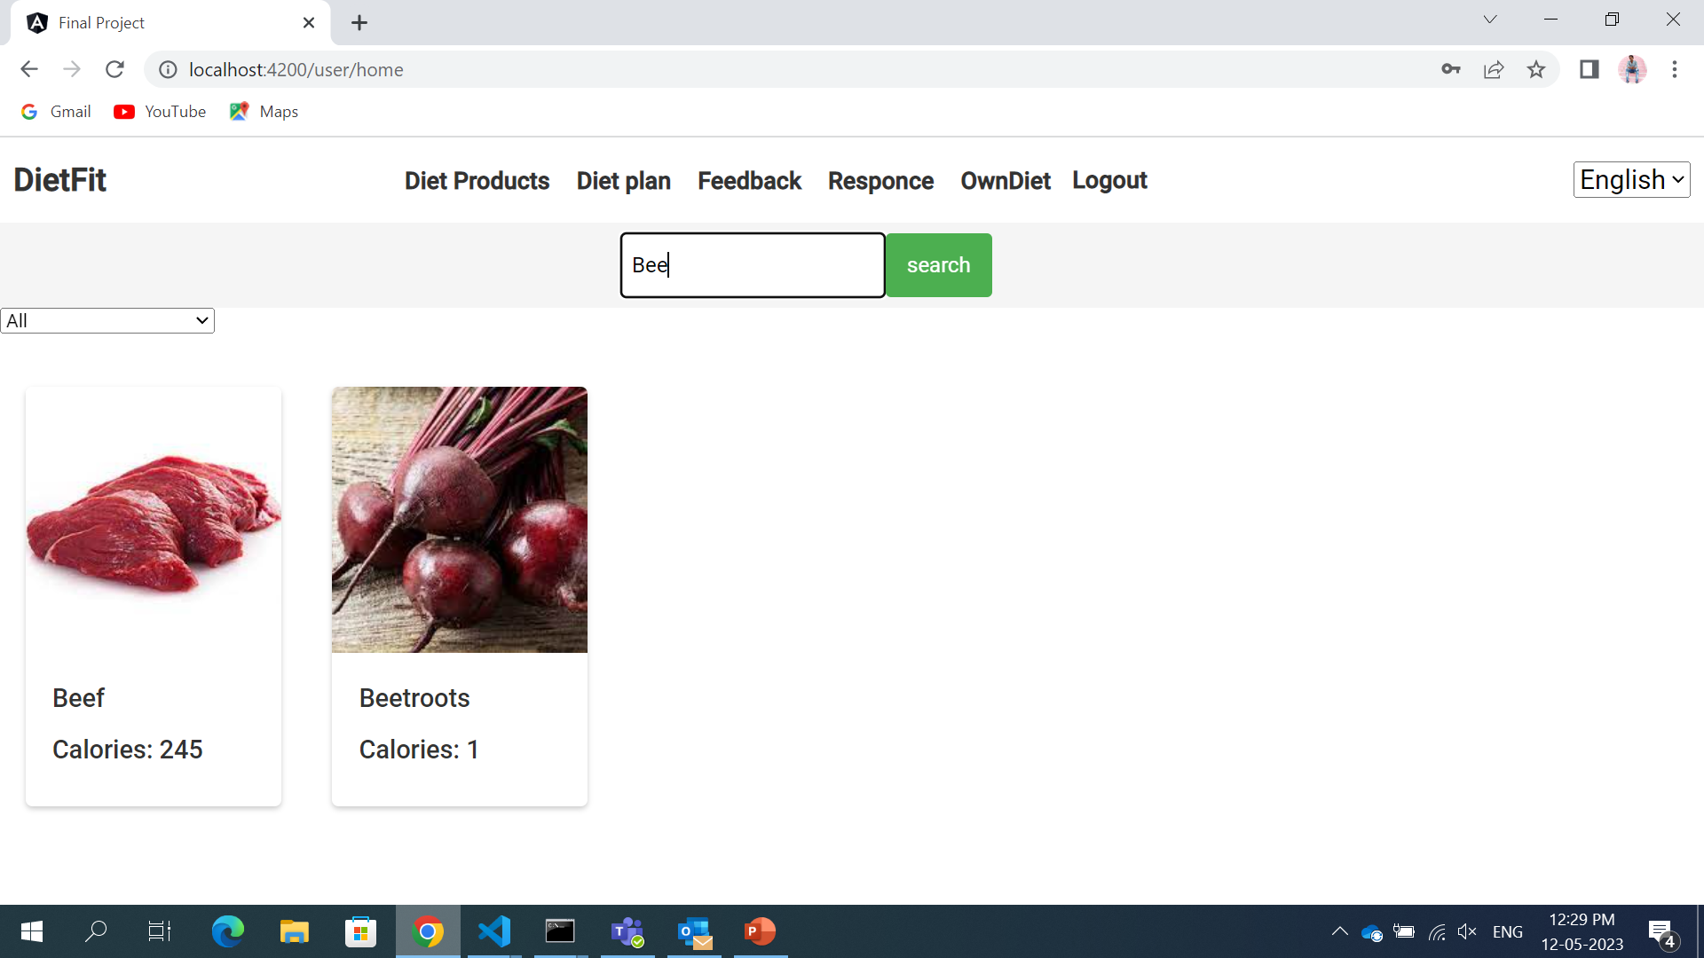
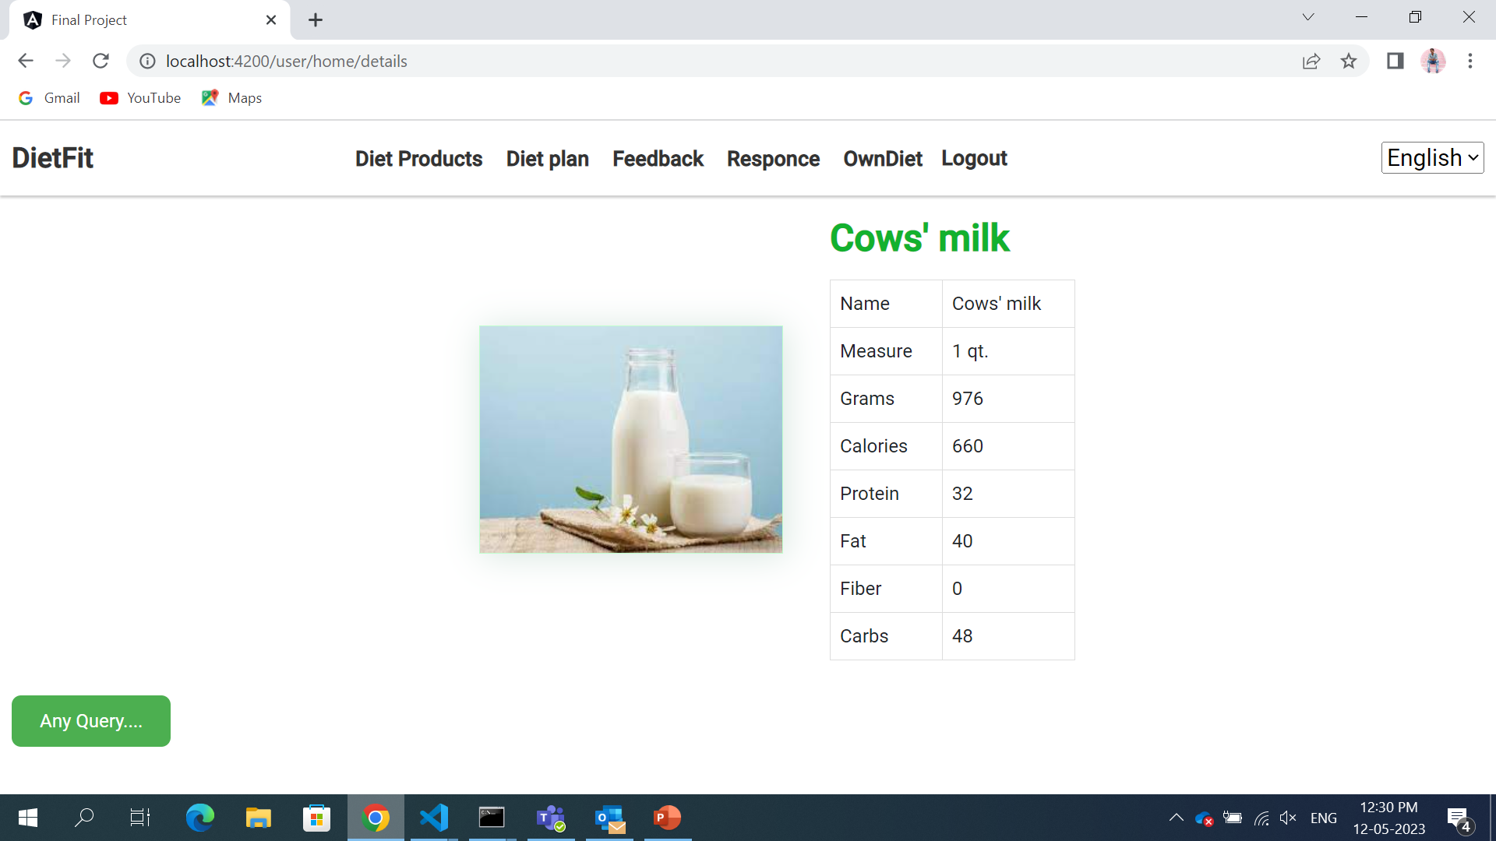
User page
In the user page they are Diet Products, Diet plan, Feedbacks, Response, Own diet and Logout
In this all products are available with their calories.
We can search and we can filter using search bar and Type Filter
And in this I have added translate language
Once we click on the product it will display the details of it.
If user have any queries about the product he/she can raise a query to admin

Slide 3
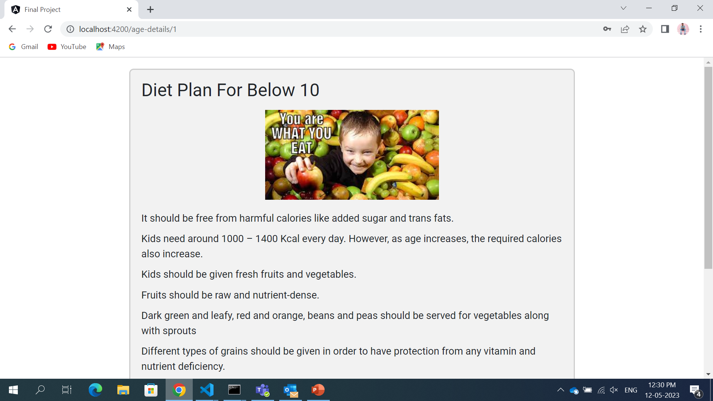
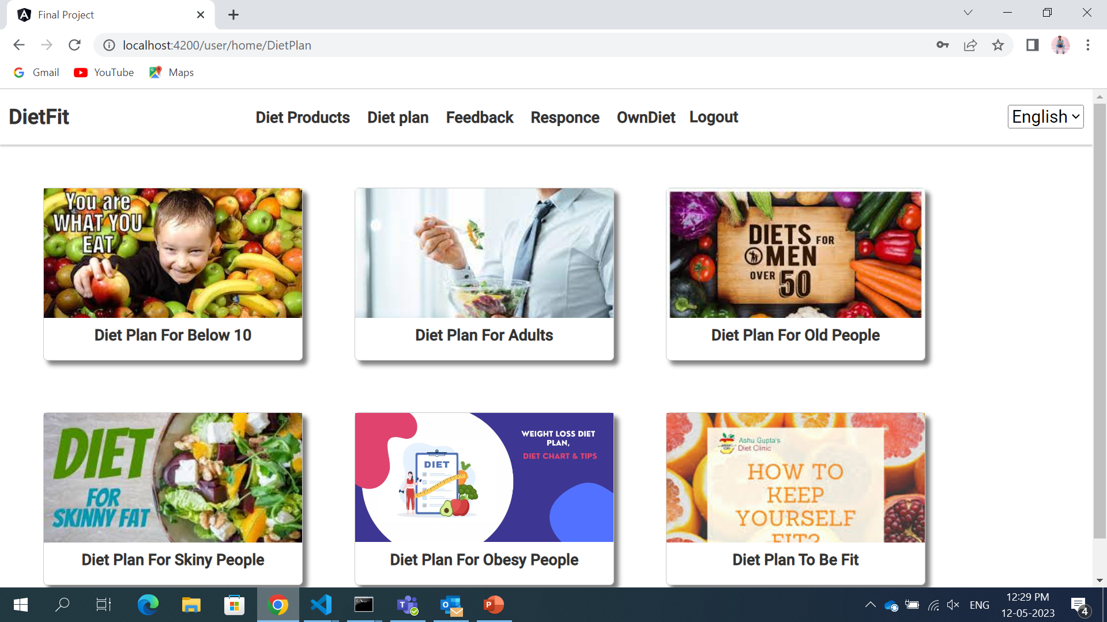
Diet Plan
Here it display the different diets plans
If u click the any diet plan it shows the details
If I click the any of the diet plan it will display the details like this….

Slide 4
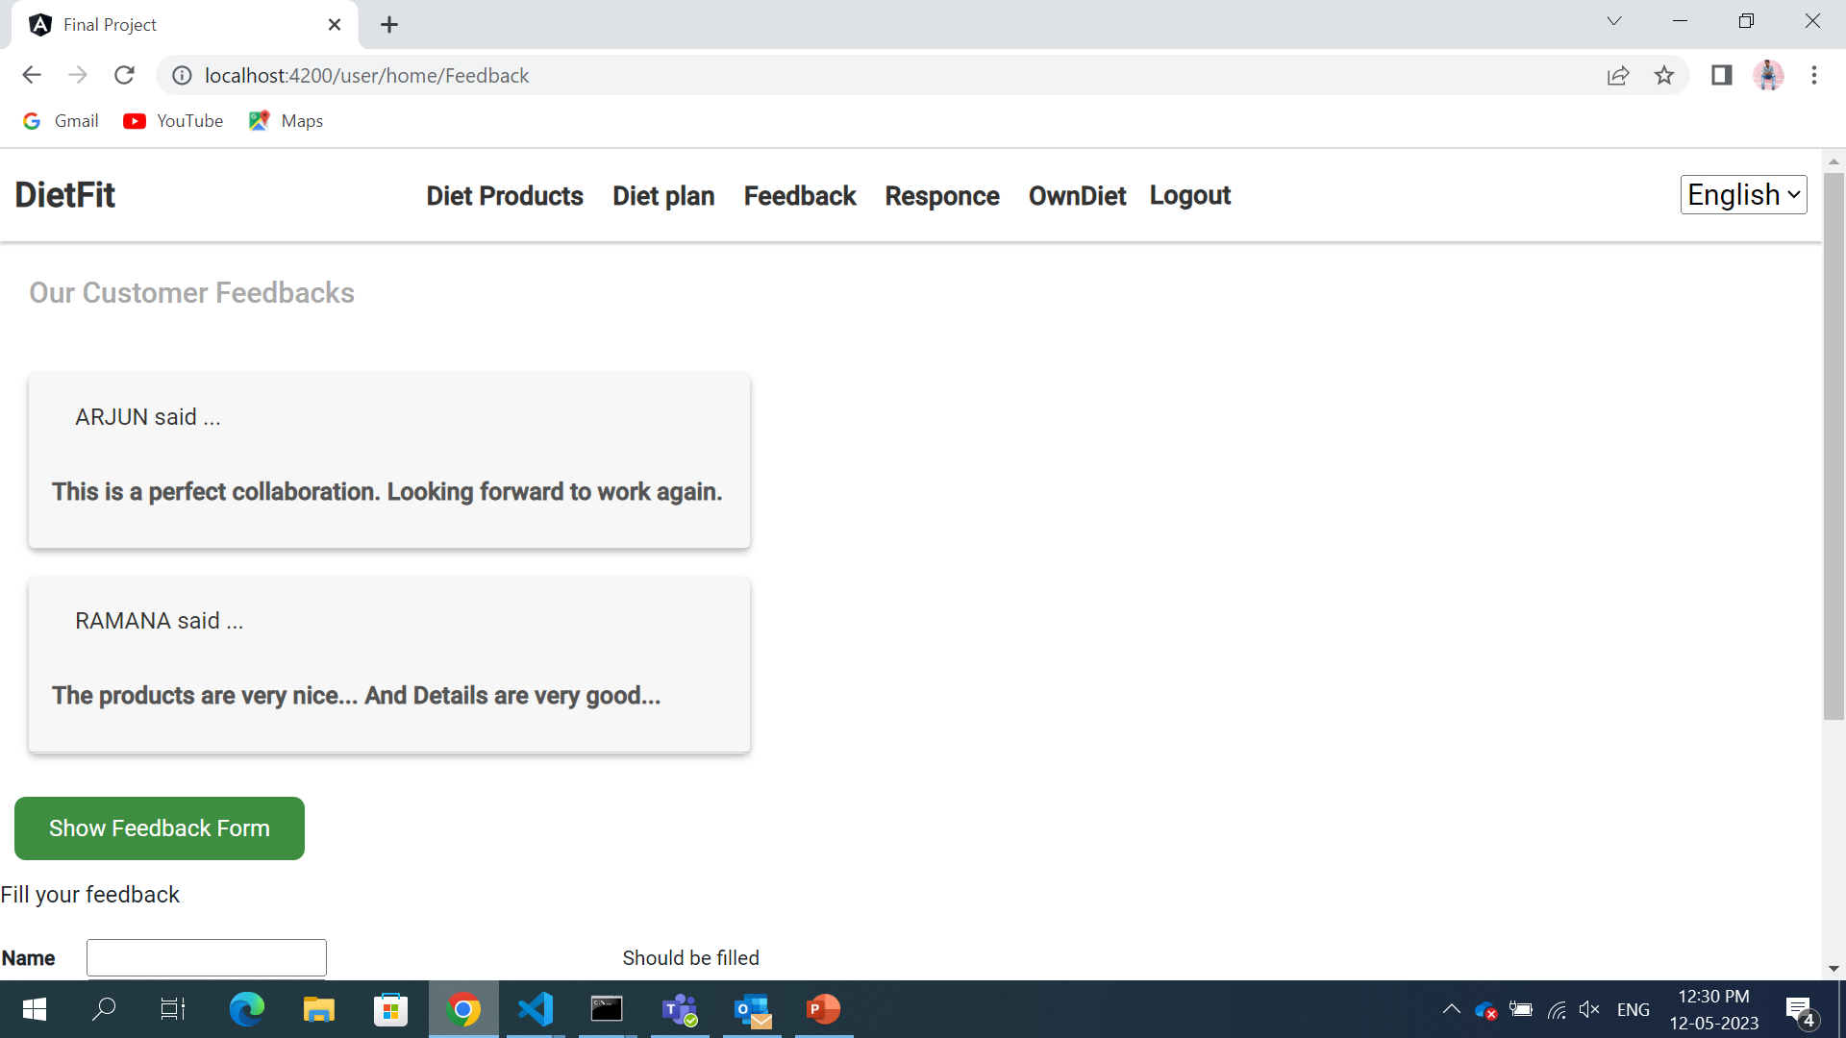
Feedbacks
In the Feedback page if a user given Feedback about the Products And it will give be sent to the admin.
If u click on Feedback form form will display and can able to view the feedbacks…

Slide 5
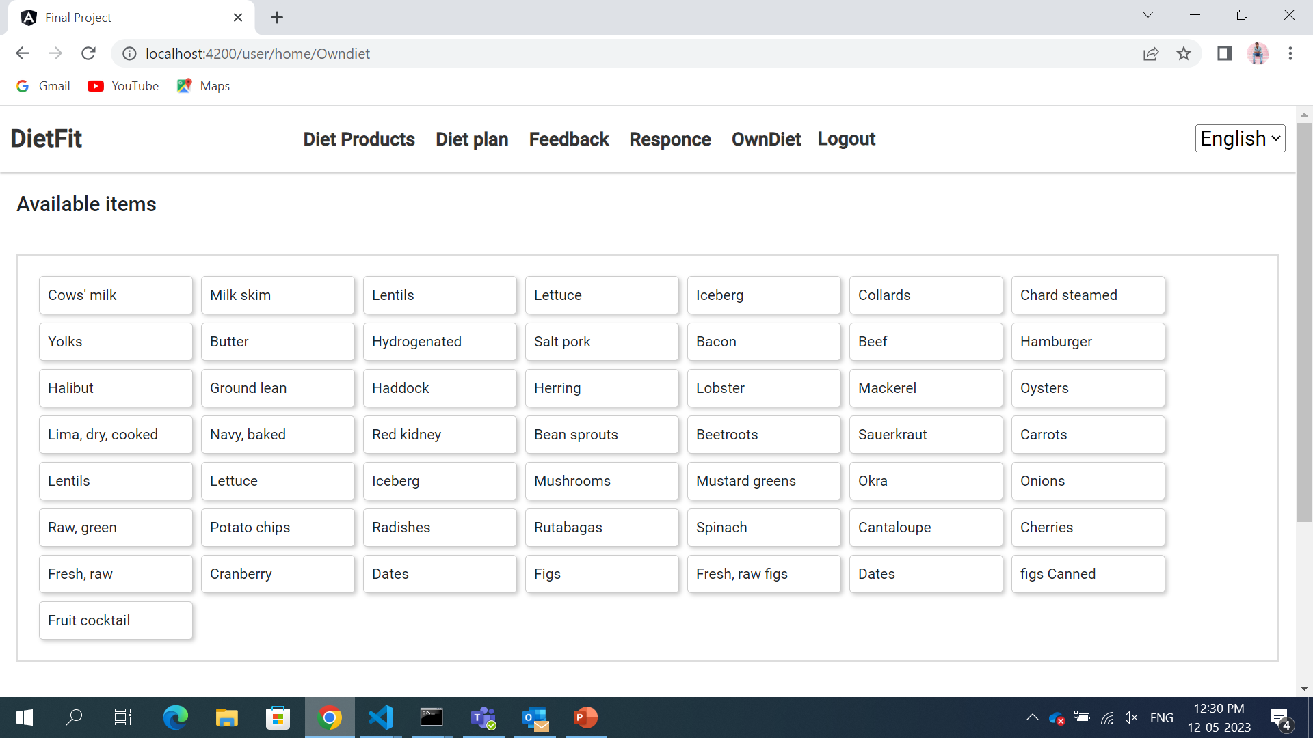
Diet plan
In the plan we can create the plan and we can add the quantity at last if I click the button it will calculations
And also we can move the items to list of items and also the create your plan

Slide 6
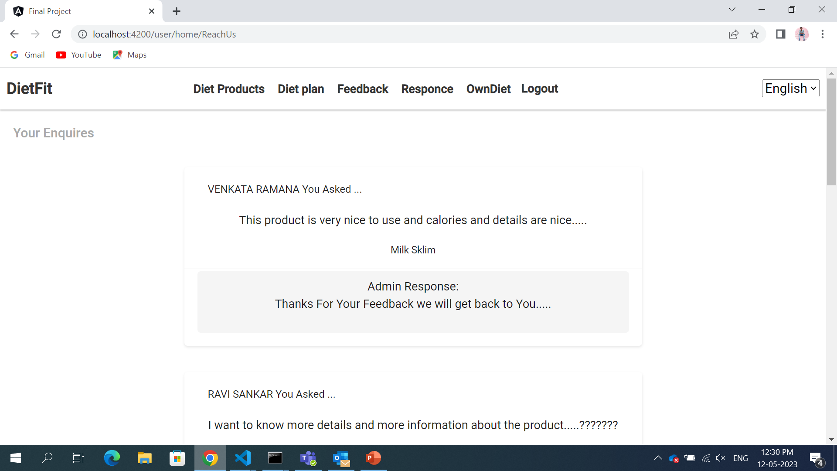
Response
In this forum both admin and user can access questions and comments
If want the user can post they queries and the admin can respond the query are the user can answer the question
In the type box I added validation

Slide 7
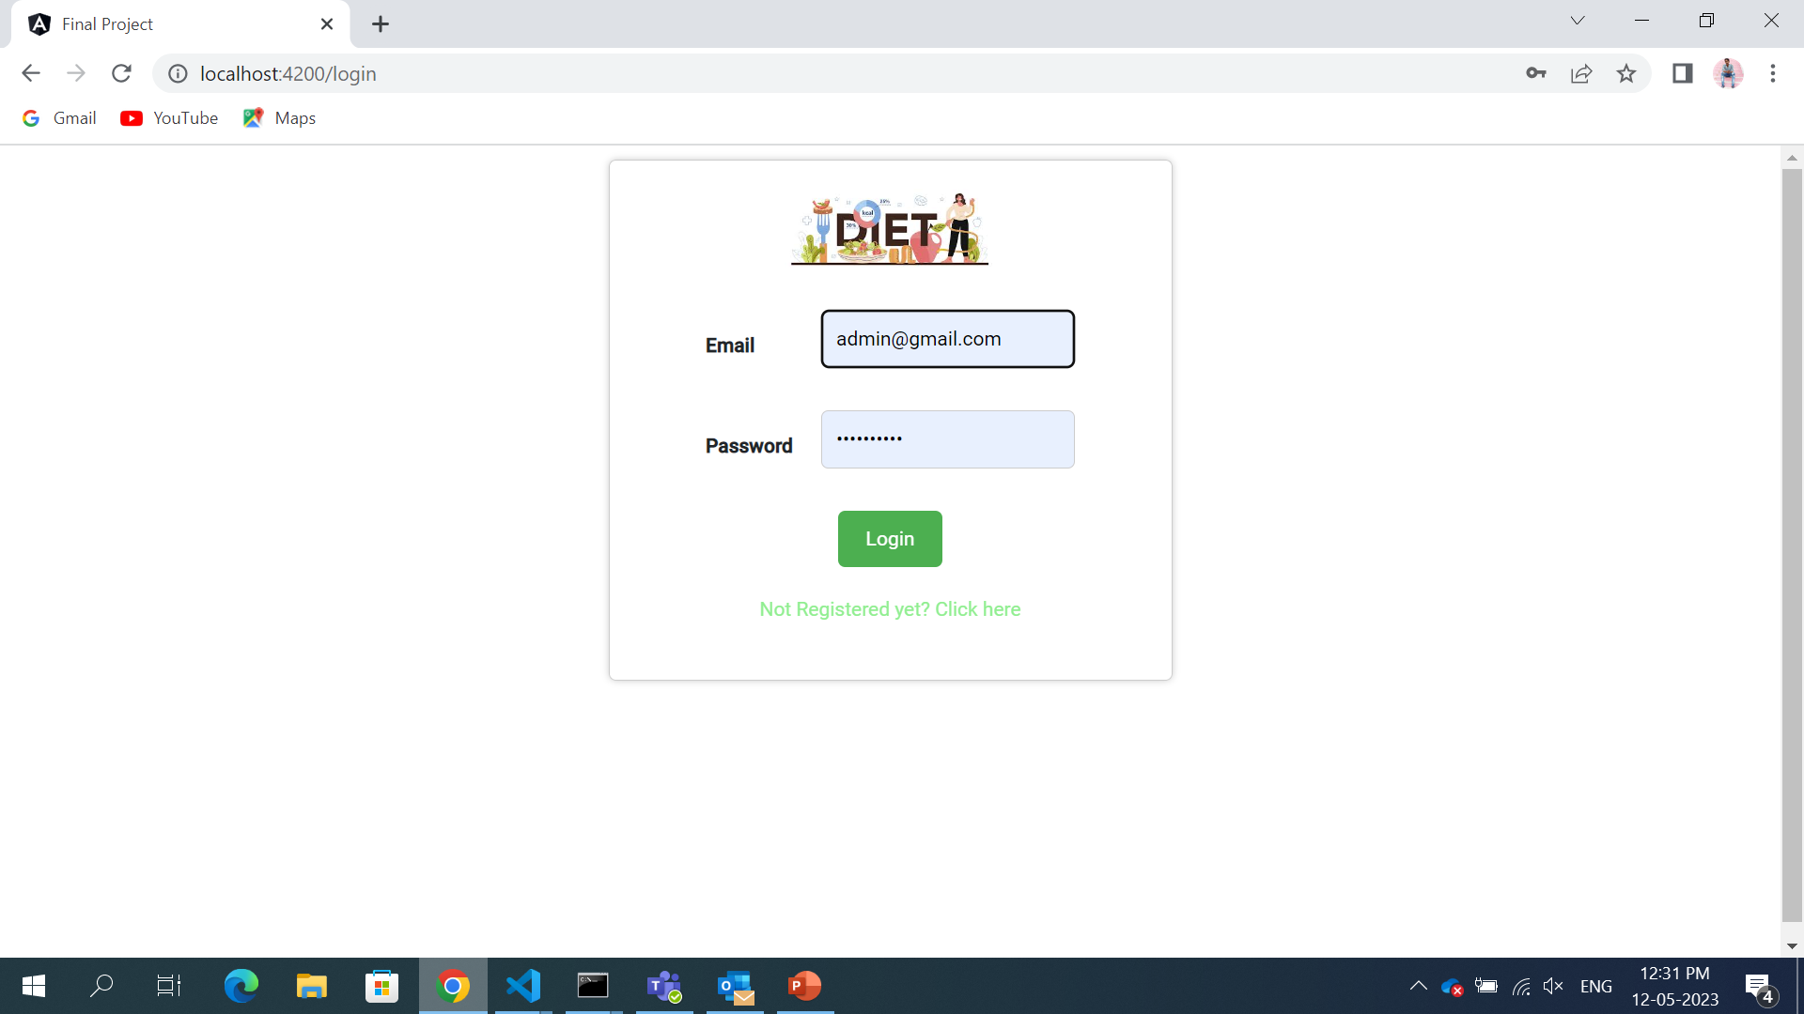
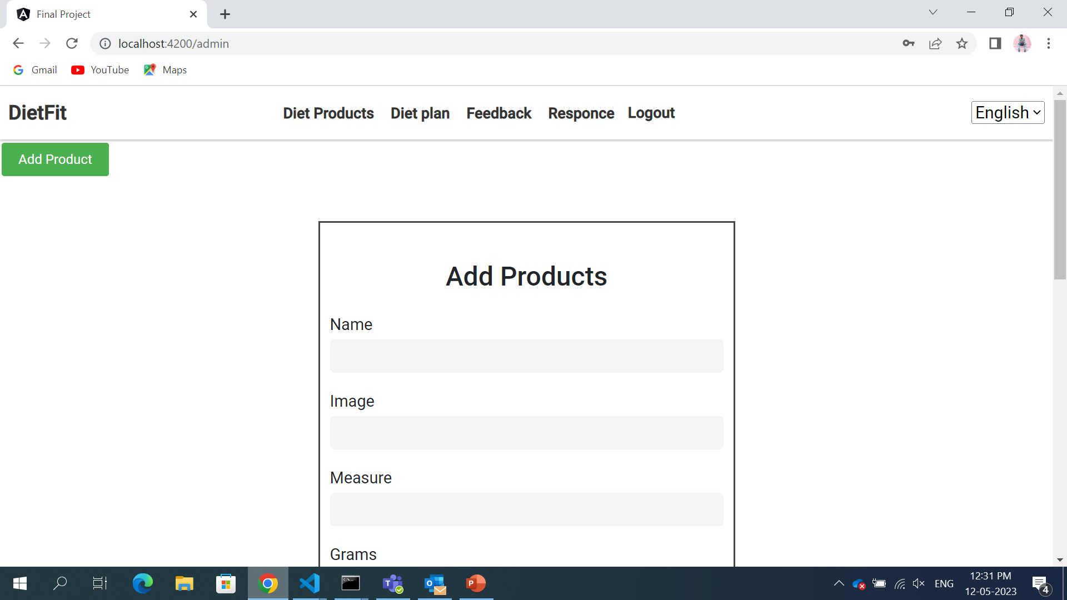
Admin
In the admin page the admin can add the product and responses
Admin can login using login page with their username and password and it redirect to admin home page.
In the page the filter pipe is there and if I click the add product it open the new page , in that we can add the product and the give the proteins etc..

Slide 8
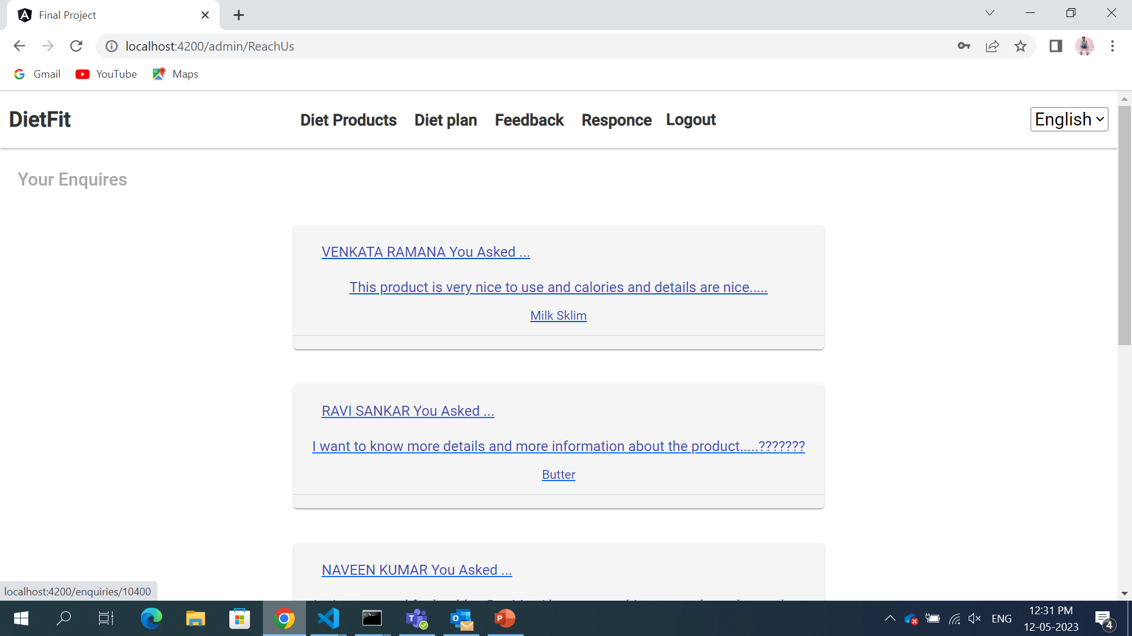
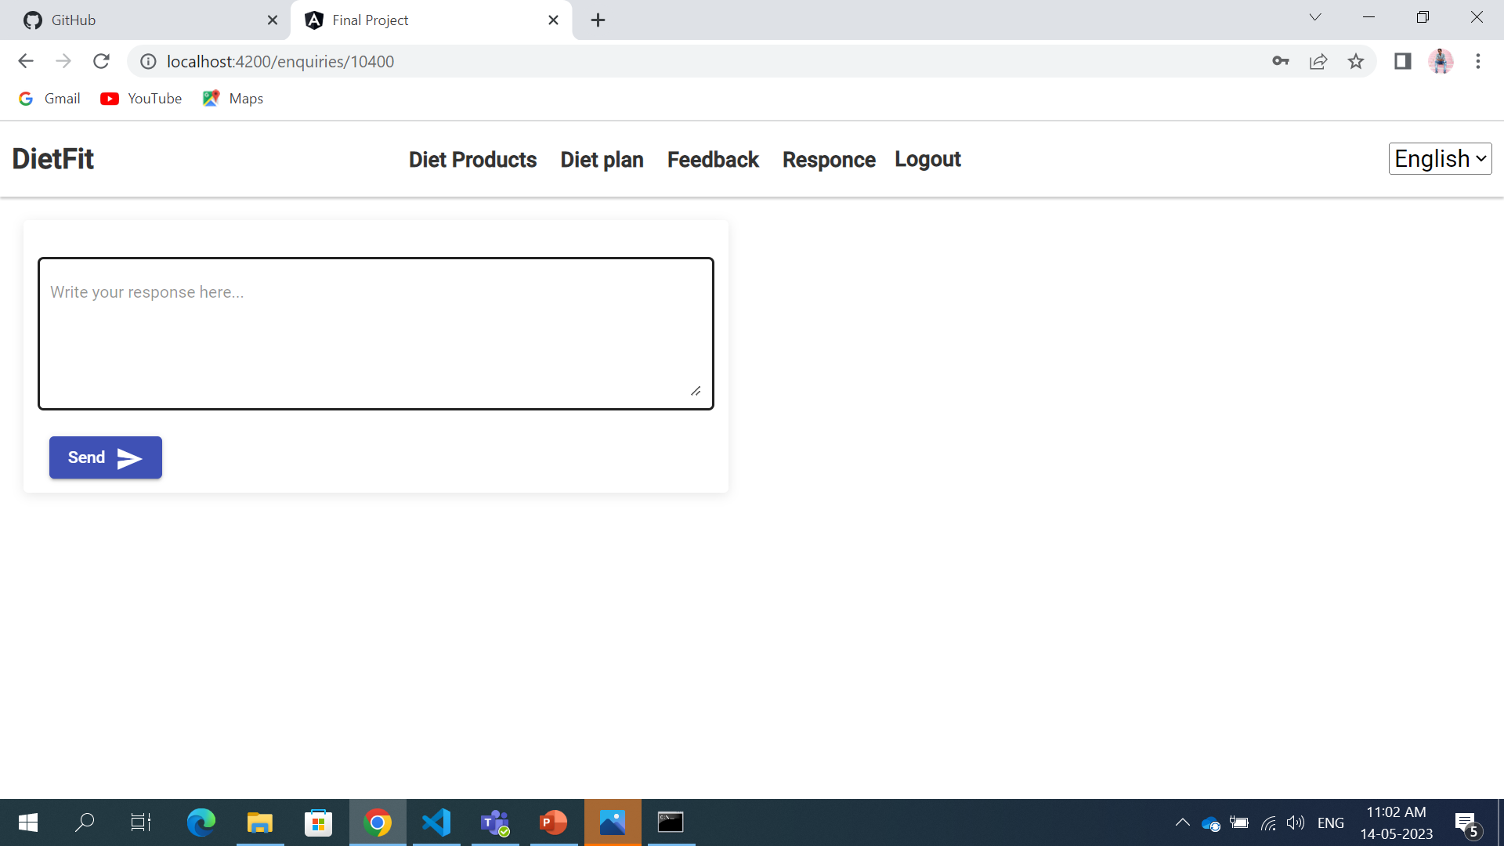
Add Responses
In the add responses page the admin can add the responses which is given by the user
If Any question asked by the user in Enquiry form it will be displayed in admin page and admin can respond to it add and user can see it in response page.
In the comments section the multiple comments are display the admin can add the responses for each question

Slide 9
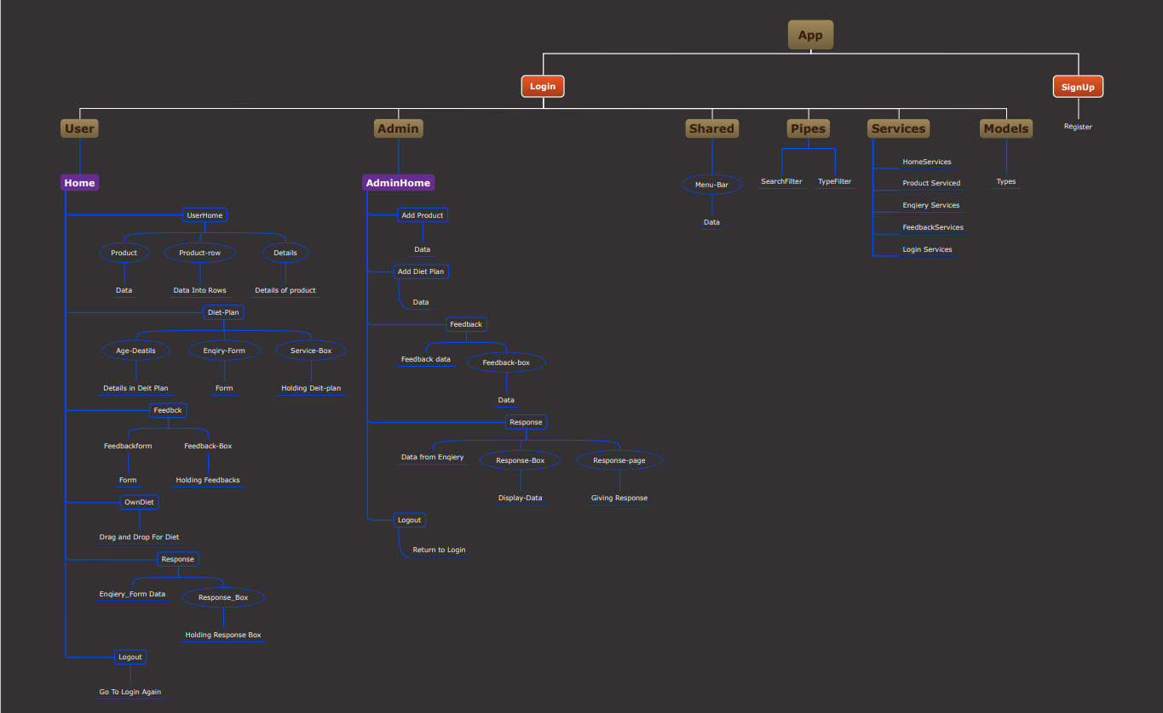
Flow Chart

